Slide 1
The Software Testing Pyramid: A Concrete Example
Jim Weaver
Vanderbilt University Medical Center
(weaver.je@gmail.com)
Source Code and Tests
https://github.com/weaverj/testpyramidexample
Selenium tests: Cindy Leffler, VUMC

Slide 2
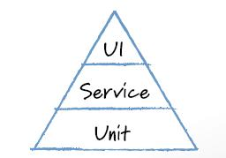
Mike Cohn’s Test Pyramid
Foundational base of unit tests.
Minimum necessary tests through user interface.
Service testing in the middle – testing services provided by the application independent of the UI.

Slide 3
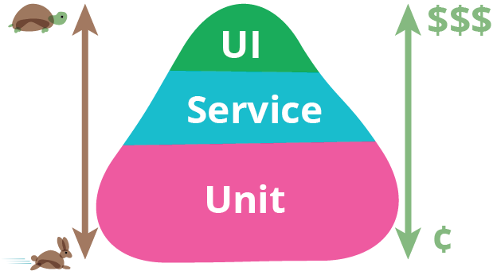
Motivations
Many teams observed with high percentage of automated tests through the UI.
UI tests are slower, more brittle, expensive.
Unit tests are easy for developers to write, usually in same language as application.
Application logic can be tested independent of UI in Service level tests - few teams observed doing this.

Slide 4
The Three Layers of the Pyramid
 | Unit | Service | UI
Appropriate Purpose | Test Units of Code, Aid with Design and Code Quality | Test Business Logic / Services | Test the User Interface
Authors | Developers | Customers and Developers | QA automation or Developers
Speed / Cost | Fast / Low | Fast to Medium / Medium | Slow / High
Orthagonal Concepts: Integration Tests, End to End tests. Decide what the above layers mean to your team.

Slide 5
Challenges
Team must have a shared understanding of the purpose of the various test layers.
Decisions must be made as to what parts of a feature to test how and in each layer.
Customer participation with service level tests may be hard to obtain.
Communication issues between different test authors resulting in duplication or gaps.

Slide 6
Test Pyramid For a Prescribing Application Feature
Examine how a team distributed tests for a feature of a real medication prescribing application.
Discuss process, team composition, technical tools used.
Look at and run working code and tests in the various layers in a demo application based on the production prescribing application.
Prescribing Application is a web-based application with a rich front-end with most business logic implemented on back-end server.

Slide 7
Team Composition and Tools
Team included developers, UX engineers, domain specialists (business analyst, clinician product owner), and QA.
Everyone not seated in same room, but all developers in one team room and close daily collaboration between everyone.
Working in Sprints / Iterations.

Slide 8
Prescribing Feature: Limit Opiate Rx Duration
When clinician is prescribing Opiates or Benzodiazepines, limit the duration of the prescription to 30 days or under.
Reject prescription and display explanation to clinician if this rule violated.
This rule will be added to existing prescription validation rules run on server.

Slide 9

Feature Test Plan
Feature Part | Unit (Junit/Jasmine) | Service (Fitnesse) | UI (Selenium + Junit)
Identify if drug being prescribed is Opiate or Benzo
Calculate number of days for duration
Rule applied to prescription and appropriate response built
Inform user in UI if rule violated

Slide 10
Implementation Process
Development driven first by the Fitnesse / Service tests that describe the requirments. Developer pairs with customer / analysts to complete fitnesse tests if necessary.
Unit tests written as code to implement as code built up to implement requirement.

Slide 11
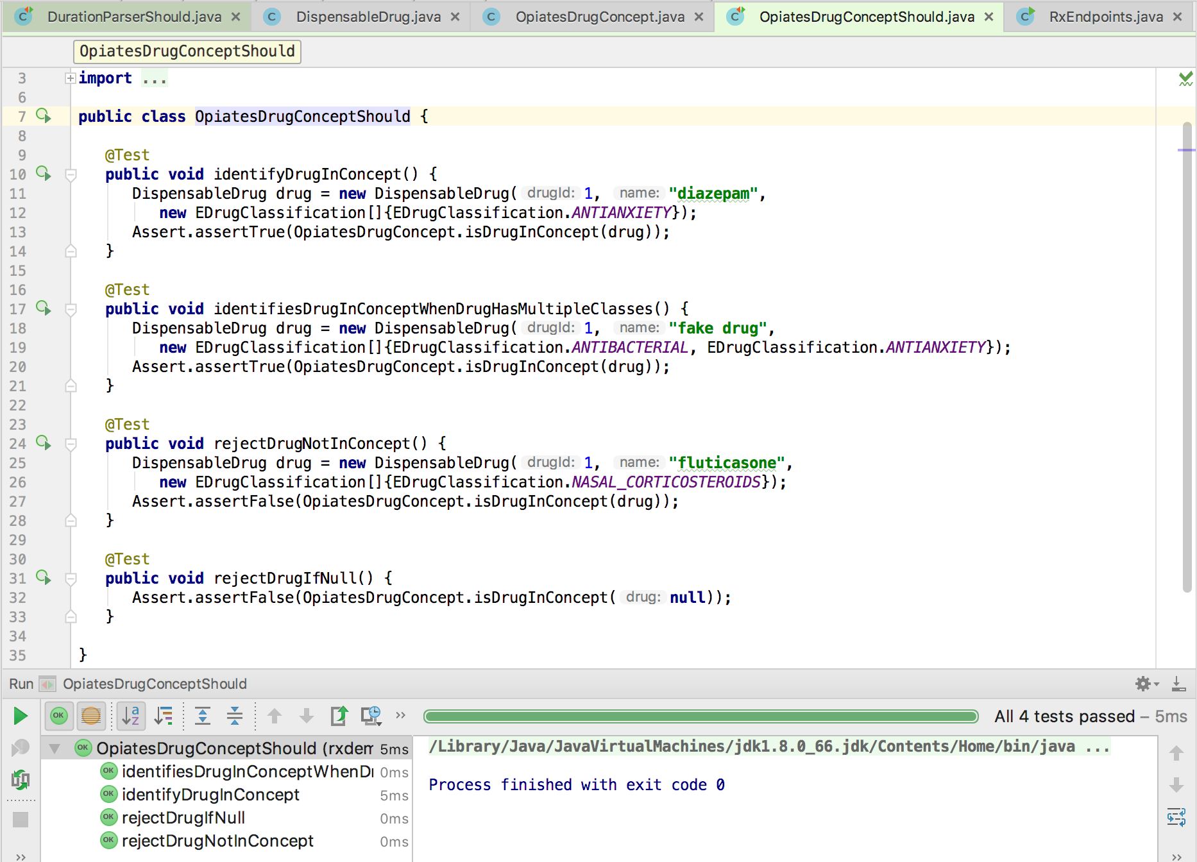
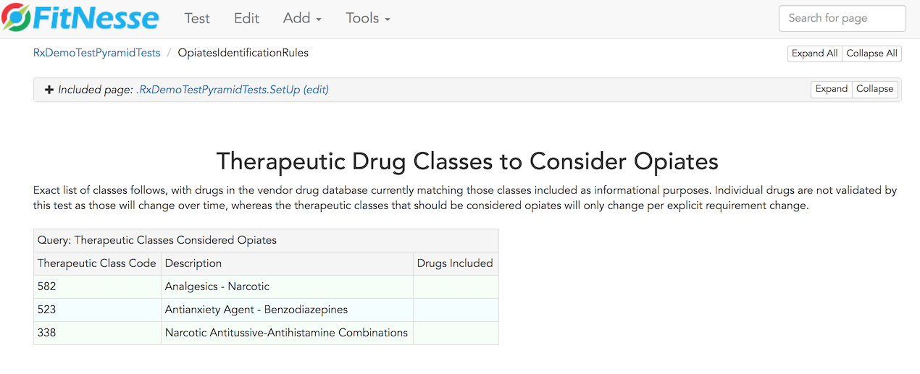
Identify Opiates / Benzos
Feature Part | Unit (Junit/Jasmine) | Service (Fitnesse) | UI (Selenium + Junit)
Identify if drug being prescribed is Opiate or Benzo
Test source
Test source
Notes:
The fitnesse tests covers the full requirements for this part of the feature – specifies each drug classification that should be considered an opiate.
OpiatesDrugConceptShould states and tests the design of the classes used to determine if a drug is in this class. DispensableDrug, EDrugClassification, and OpiatesDrugConcept classes interact to implement this feature.
Unit test is testing the design and implementation of the units of code supporting this part of the feature, fitnesse is specifying and testing the requirements for this part of the feature. There is little overlap or duplication between the tests for this reason – they complement, not duplicate one another.

Slide 12
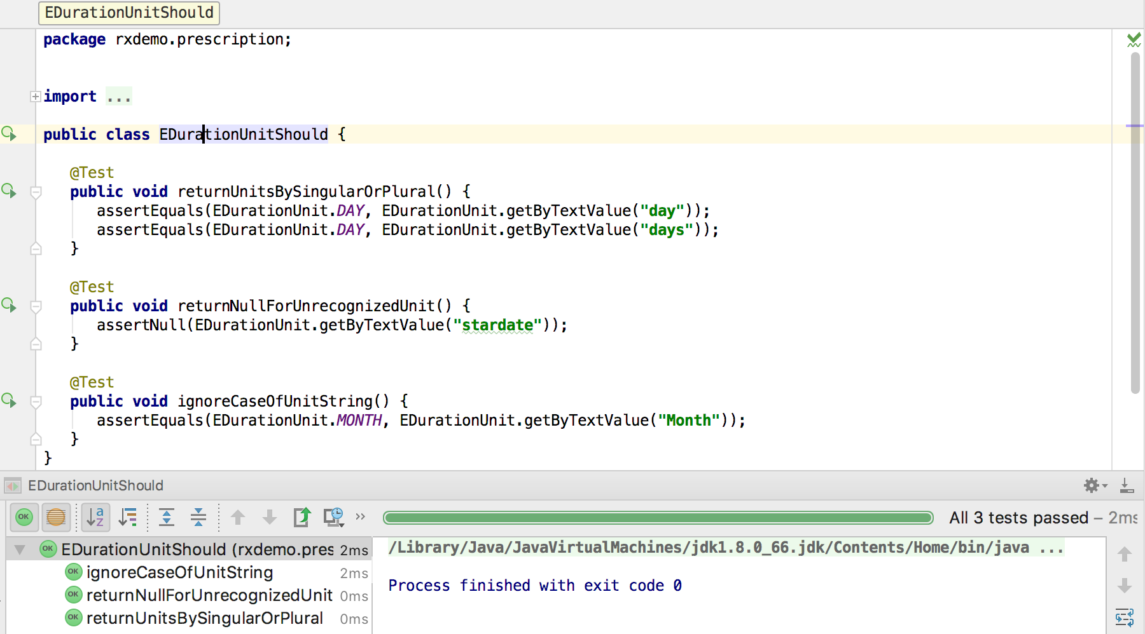
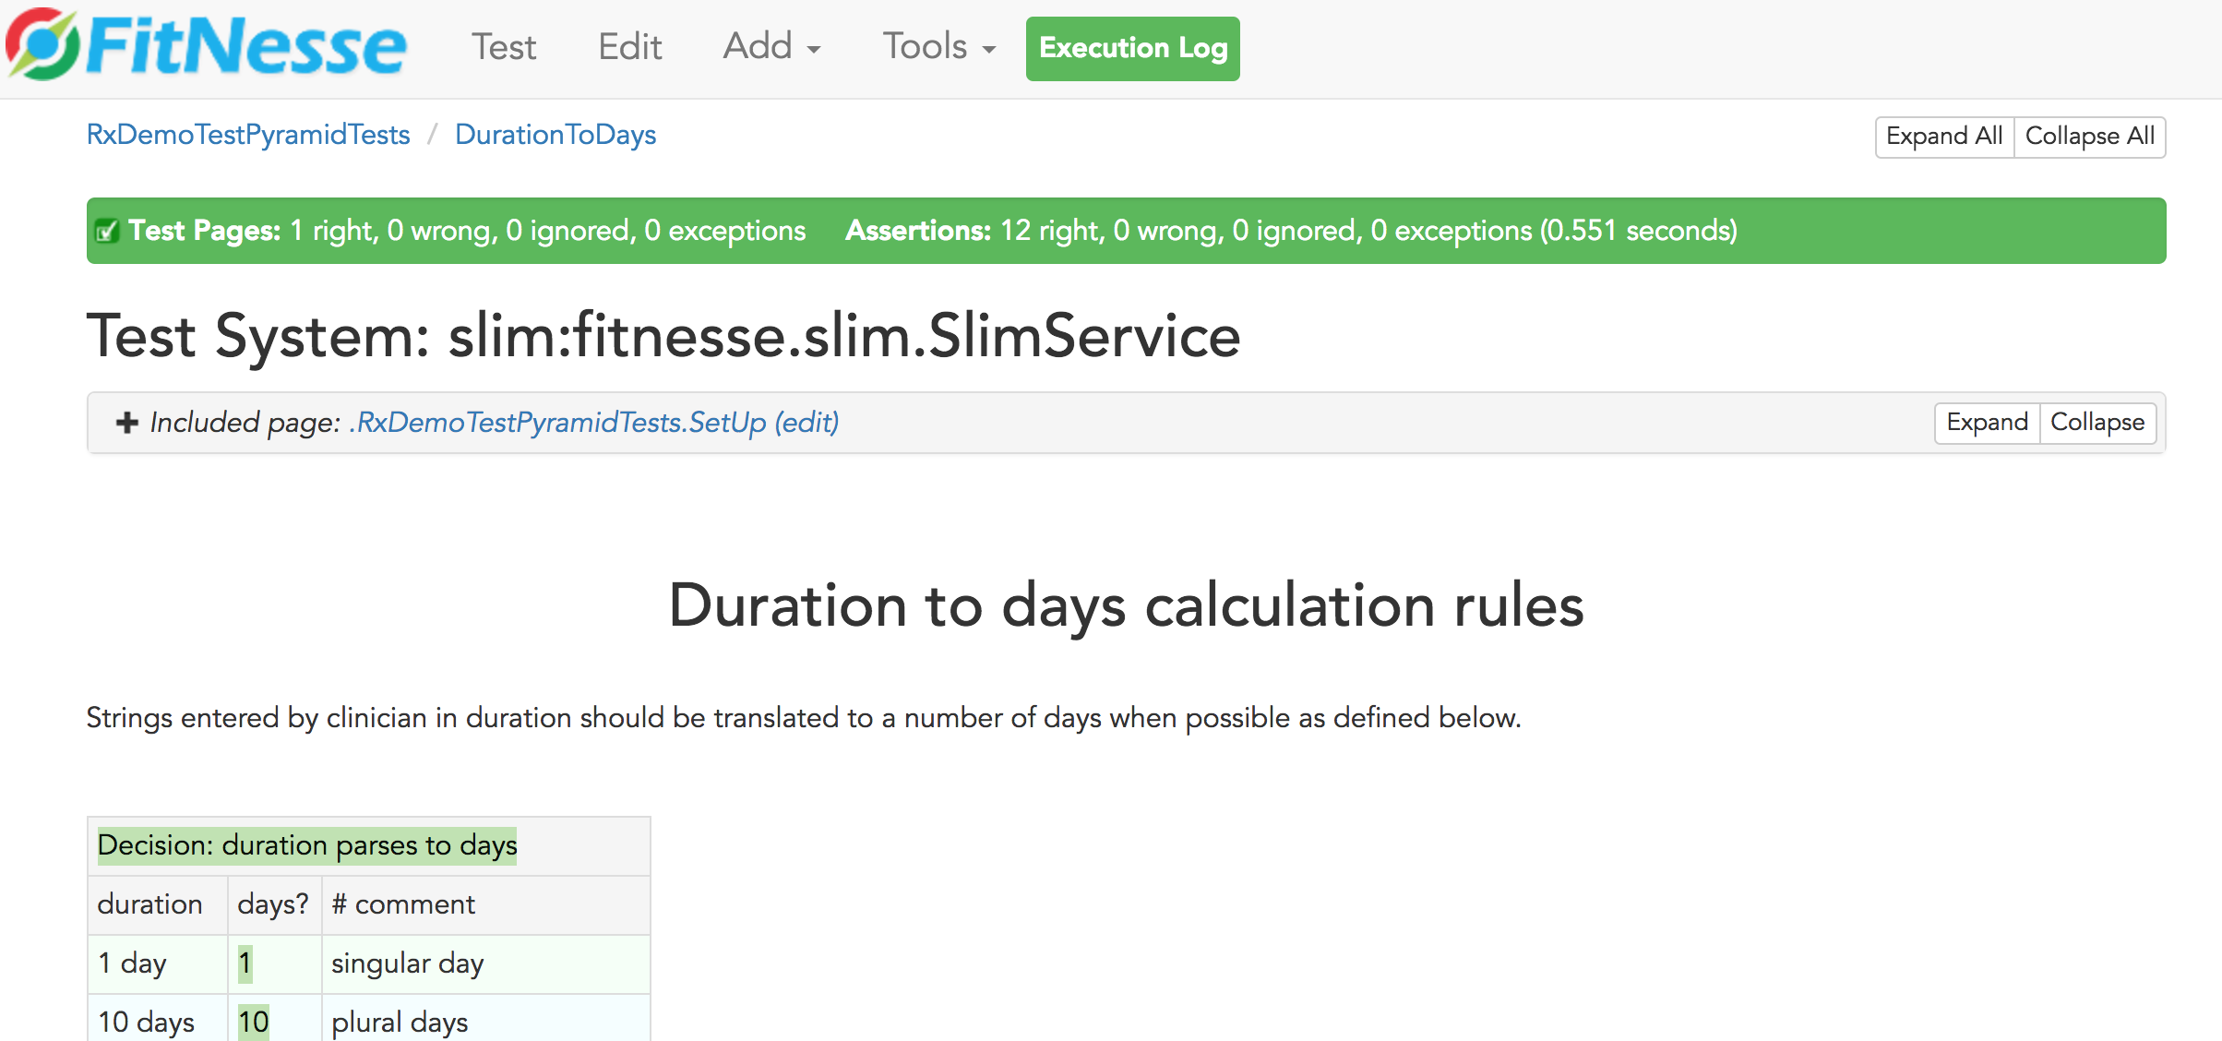
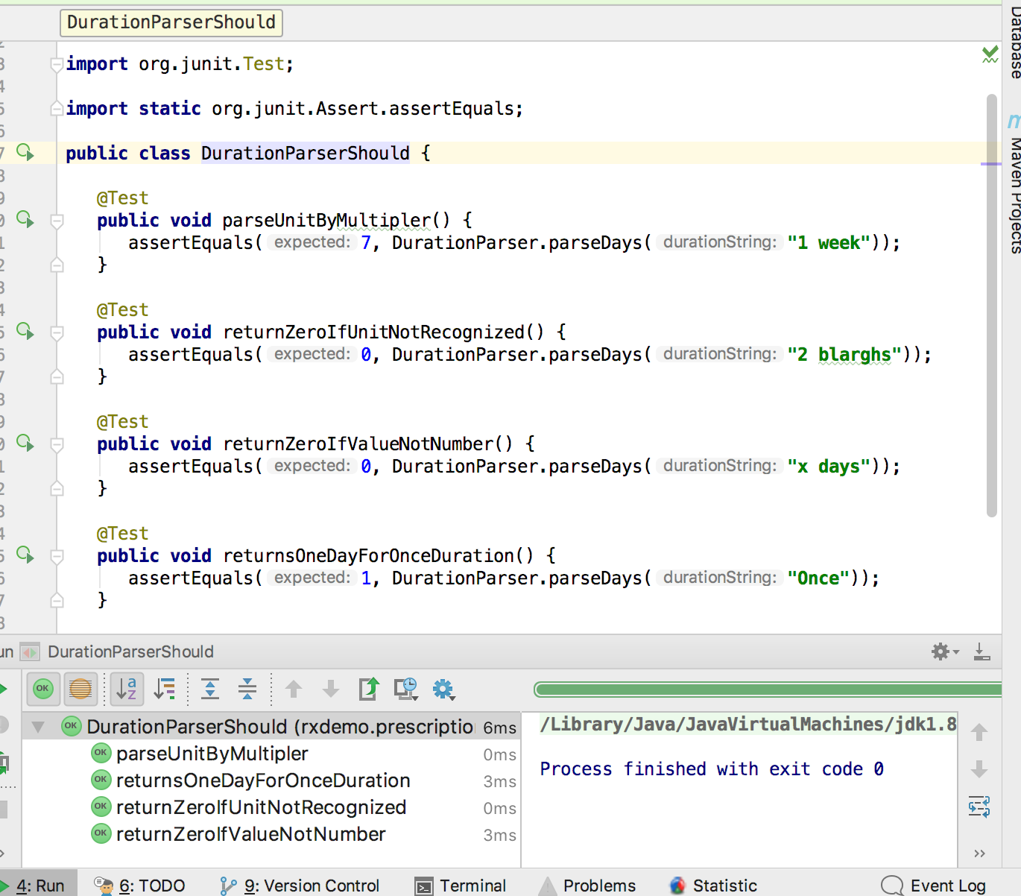
Calculate Duration in Days
Feature Part | Unit (Junit/Jasmine) | Service (Fitnesse) | UI (Selenium + Junit)
Calculate number of days for duration
DurationParserShould
DurationToDays
EDurationUnitShould
Notes:
The fitnesse test covers a wide variety of parsing scenarios.
Two classes provide the implementation for this part of the feature, EDurationUnit and EDurationParser. EDurationUnit test verifies how duration units are expressed. The test for EDurationParser covers a few of the duration calculation scenarios covered in the fitnesse test, but not the full range – small amount of overlap.

Slide 13
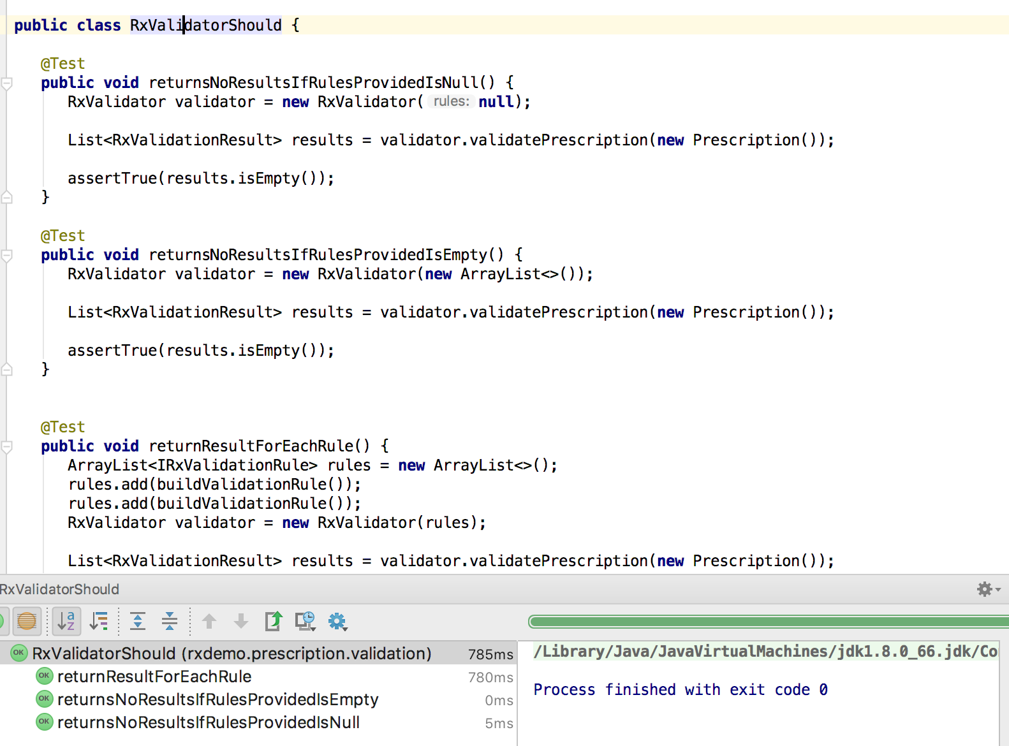
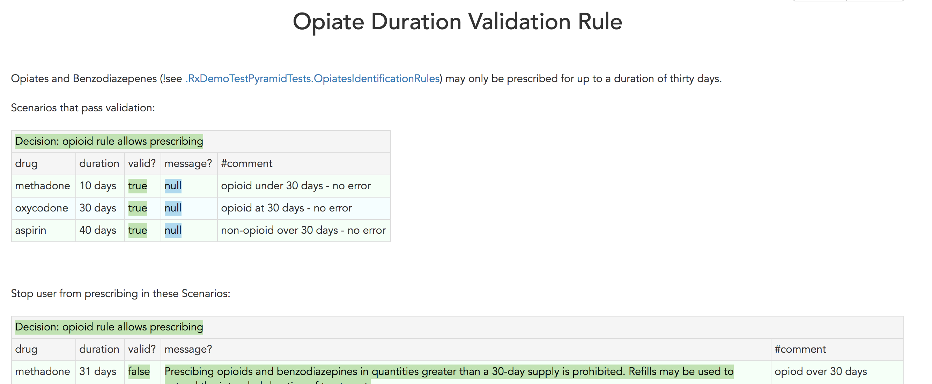
Duration Validation Rule Applied
Feature Part | Unit (Junit/Jasmine) | Service (Fitnesse) | UI
Rule applied to prescription and appropriate response built
RxValidatorShould
OpiateDurationRule
OpiateDurationValidationRuleShould
ValidatePrescriptionCommandShould
Notes:
The fitnesse test covers a full range of cases which will both pass and fail the validation rule. It depends on both opiate identification and duration parsing logic.
RxValidator is a class for running multiple validation rules, represented by IRxValidationRule interface, against a prescription. Each rule will return an RxValidationResult that indicates whether the prescription is valid with respect to that rule, and if not what message should be displayed and which prescription fields are related to the failure if any. The RxValidatorShould unit test verifies this rules runner functions correctly, but using fake rules.
ValidatePrescriptionCommand is the initial class invoked to run all prescription validation rules when a prescription is sent from a client browser. It runs all the rules and returns a response to the client. ValidationPrescriptionCommandShould tests this class with fake rules.
OptateDurationValidationRuleShould tests the validation rule used for this feature. It tests a few scenarios, including edge case like a null drug, but does not cover all business scenarios as they are covered by fitnesse test.

Slide 14
Inform User in UI if Rule Violated
Feature Part | Unit (Junit/Jasmine) | Service (Fitnesse) | UI (Selenium / Java)
Inform user in UI if rule violated
RxValidatorShould
App.spec.js
RxValidationResponseHandler.spec.js
Notes:
The fitnesse test covers a full range of cases which will both pass and fail the validation rule. It depends on both opiate identification and duration parsing logic.

Slide 15
Summary

Slide 16
References
Succeeding with Agile: Software Development Using Scrum by Mike Cohn, Addison-Wesley, 2009
The Forgotten Layer of the Test Automation Pyramid, Mike Cohn, 2009.
TestPyramid, Martin Fowler, 2012

